Slide 1


STARK HEALTH CLINIC
DIABETES PREDICTION
Using Machine Learning
Presented by:
Victoria Nwobodo
https://github.com/vezeukwu/Diabetes-Prediction-EDA-and-ML

Slide 2


INTRODUCTION
Diabetes affects millions globally, requiring early detection for better management.
Current traditional diagnostic methods in use is time-consuming and reactive.
Early diagnosis using machine learning can enhance and help doctors make data-driven decisions.
SITUATION
Stark Health Clinic is a leading healthcare provider whose patients are at risk of developing diabetes.
The clinic is concerned about the huge cost of treatment
Prevent late intervention that could lead to severe health complications by early detection.
TASK
Develop a predictive model to classify patients as diabetic or non-diabetic to improve early diagnosis .
Prevent missed opportunities for timely intervention by developing an accurate predictive model .
Handle data preprocessing, Feature selection, and Evaluation to ensure high model performance

Slide 3
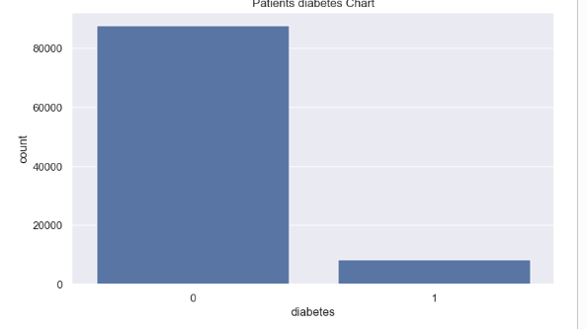
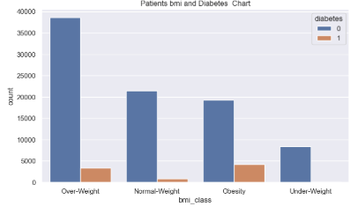
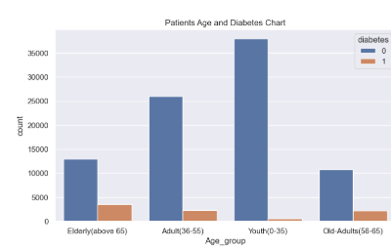
ACTIONS TAKEN
Data Cleaning |Exploratory Data Analysis |Weight Assignment addressing the noted class imbalance |Model Training and Evaluation using various Machine Learning Model.
Insights:
90% of patients presented are without diabetes – this leads to class imbalance in model training
42% of patients are overweight with about 10% being diabetic and 20% of obese patients are diabetic.
16% Elderly with about 20% of them diabetic

Slide 4
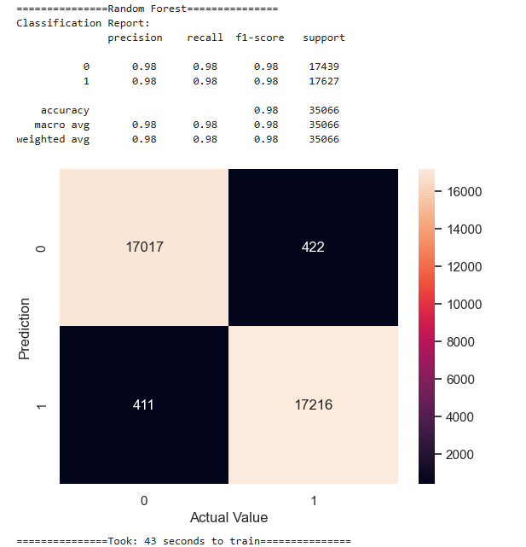
Model Evaluation and its Performance Metrics
98% Accuracy: Random Forest model correctly classifies most of the test data
98% Precision & Recall: Correct positive predictions while effectively capturing almost all true positive cases.
RESULT
Achieved 98% accuracy with Random Forest.
Enhance early diagnosis.
Reduced false negatives, ensuring fewer missed diabetic cases.
Improved decision-making by providing clear feature
explanations.

Slide 5
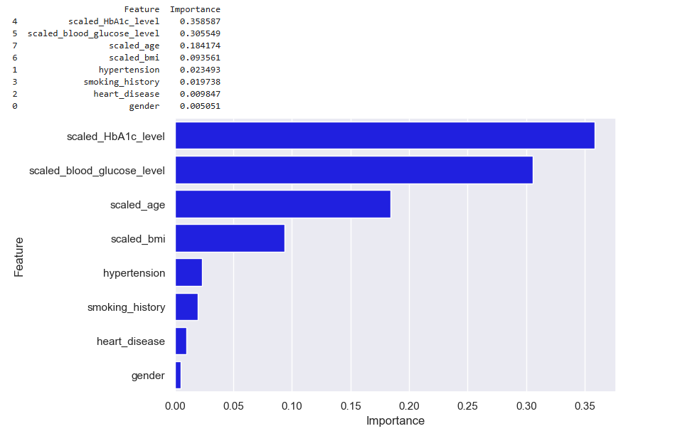
Feature Importance
Recommendation:
Monitor Important Features:
Blood Sugar Level,
Blood Glucose Level,
Age and patients’ BMI
CONCLUSION
The model demonstrates high accuracy, strong precision and recall.
The model took 43 seconds to train, indicating reasonable training efficiency.
This Random Forest model is well-optimized for the classification task, providing high reliability in predicting outcomes.

Slide 6
THANK YOU

